Slide 1
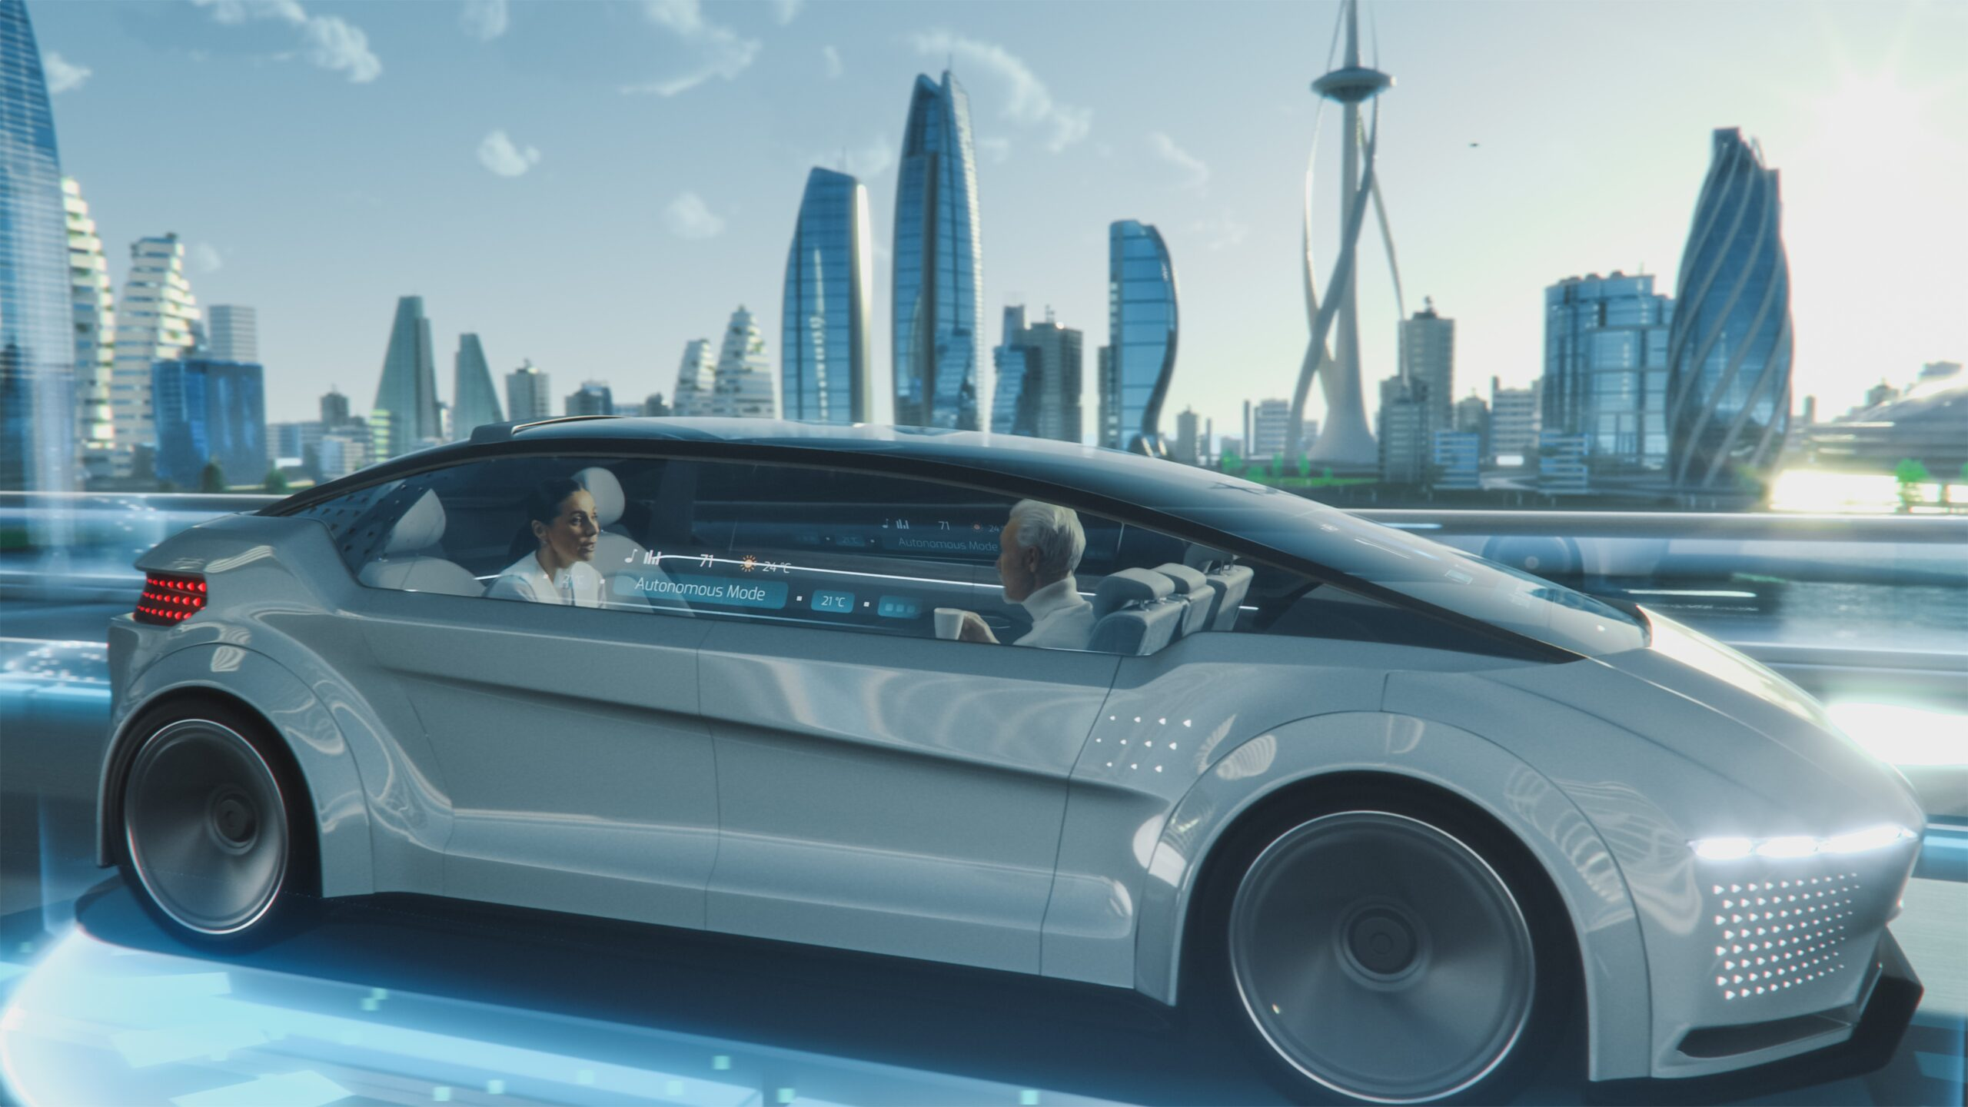
Autonomous car
Neil Ross Daniel

Slide 2
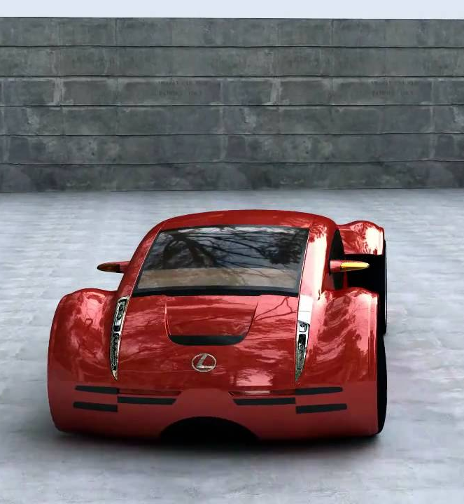
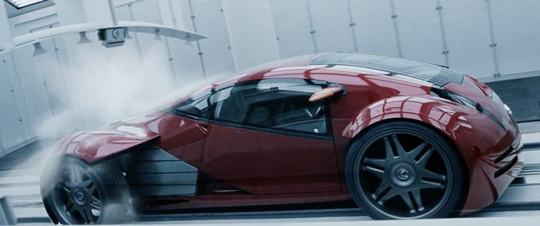
Lexus 2054
Steven Spielberg
Lexus
Lexus 2054 coupe
Notes:
In 2002 Steven Spielberg was directing a movie taking place in 2054: Minority Report. For the transportation Steven Spielberg asked Lexus to make cars for his upcoming movie because he knew that Lexus would be looking to designing how cars on the highways would be in the future.
Lexus delivered and designed two cars: the Lexus 2054 coupe and the Lexus 2054 Mag-lev pod.
The Lexus 2054 coupe is : is a 2-seater personal sports car with organic recognition, personal DNA recognition entry and ignition system.

Slide 3
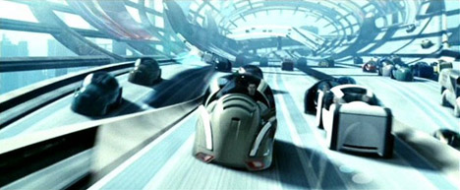
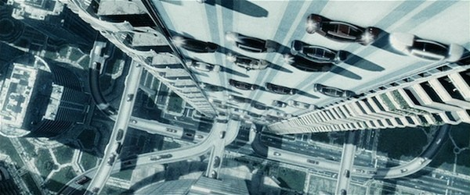
Lexus 2054 Mag-lev Pod
Notes:
The Lexus 2054 Maglev pod: is a personal transport pod that uses magnetic fields to move.

Slide 4
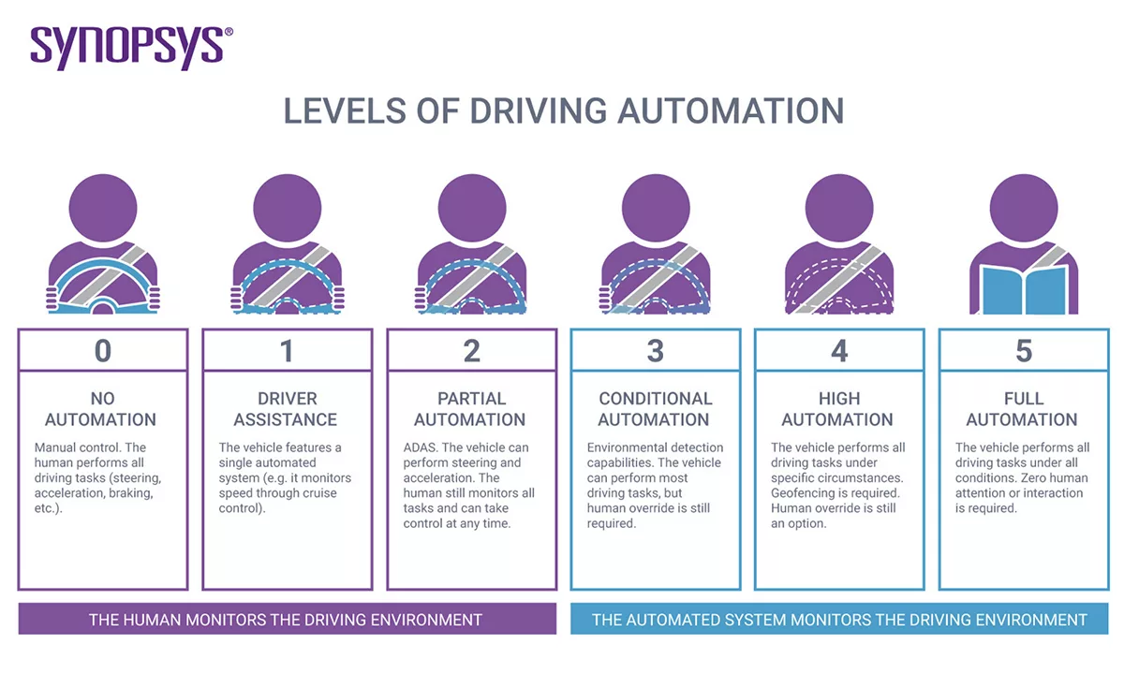
(Synopsys, 2022)
Notes:
Level 0 (No Driving Automation) Most vehicles on the road today are Level 0: manually controlled.
Level 1 (Driver Assistance) This is the lowest level of automation. The vehicle features a single automated system for driver assistance, such as steering or accelerating (cruise control). Adaptive cruise control, where the vehicle can be kept at a safe distance behind the next car, qualifies as Level 1 because the human driver monitors the other aspects of driving such as steering and braking.
Level 2 (Partial Driving Automation) This means advanced driver assistance systems or ADAS. The vehicle can control both steering and accelerating/decelerating. Here the automation falls short of self-driving because a human sits in the driver’s seat and can take control of the car at any time. Tesla Autopilot and Cadillac (General Motors) Super Cruise systems both qualify as Level 2.
Level 3 (Conditional Driving Automation) Level 3 vehicles have “environmental detection” capabilities and can make informed decisions for themselves, such as accelerating past a slow-moving vehicle. But―they still require human override. The driver must remain alert and ready to take control if the system is unable to execute the task
Level 4 (High Driving Automation) The key difference between Level 3 and Level 4 automation is that Level 4 vehicles can intervene if things go wrong or there is a system failure. In this sense, these cars do not require human interaction in most circumstances. However, a human still has the option to manually override.
Level 5 (Full Driving Automation) Level 5 vehicles do not require human attention―the “dynamic driving task” is eliminated. Level 5 cars won’t even have steering wheels or acceleration/braking pedals. They will be free from geofencing, able to go anywhere and do anything that an experienced human driver can do. Fully autonomous cars are undergoing testing in several pockets of the world, but none are yet available to the general public.

Slide 5
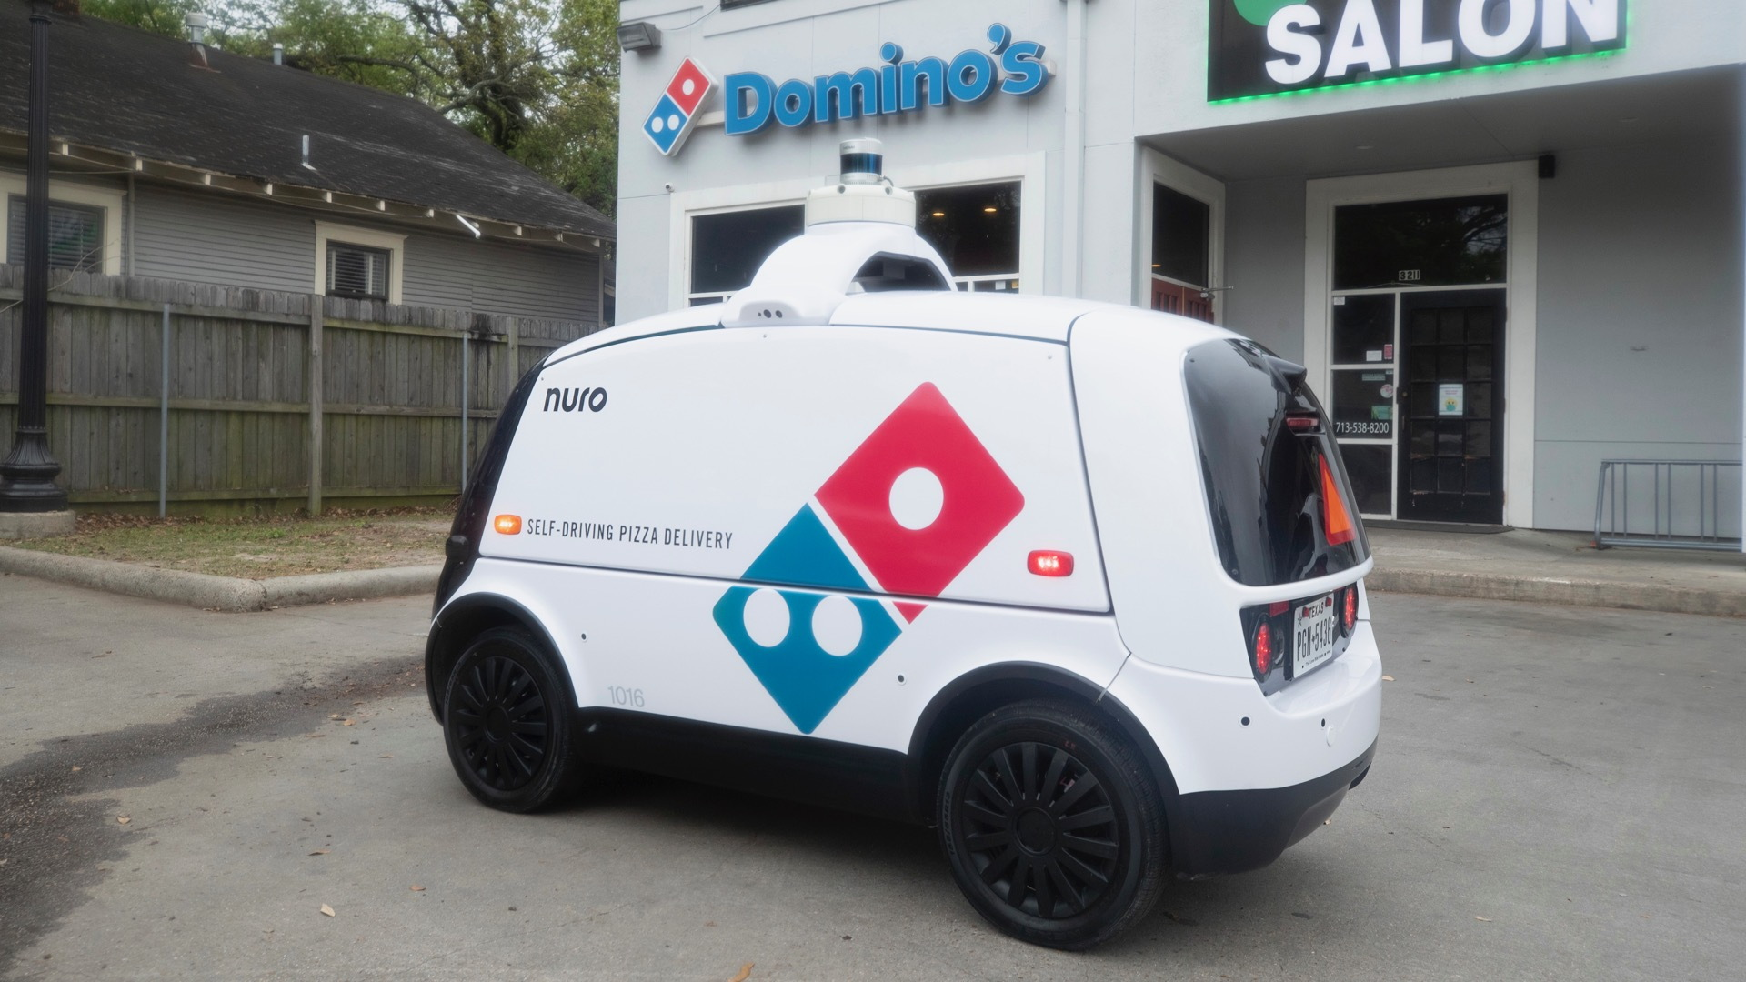
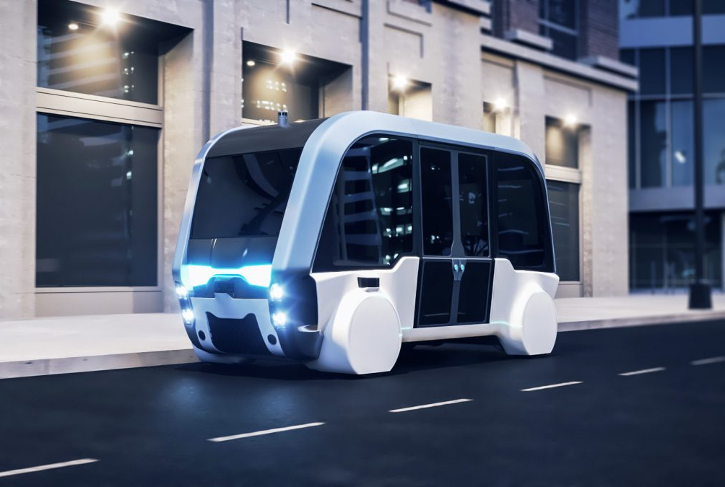
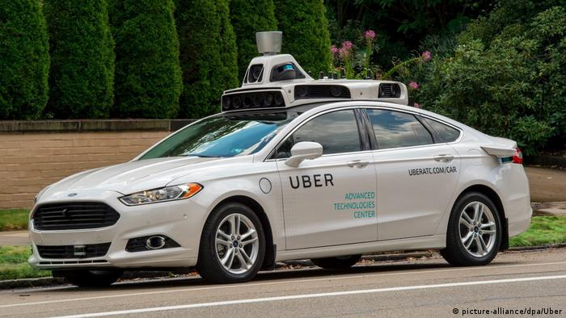
Possible applications:
(Stilgoe, 2017), (Hitachi, 2020)
Notes:
Self-driving shuttles have made significant step in recent years. The shuttles in this program are expected to achieve Level 4 autonomy and enable fully automated driving. Both passengers and cargo will be transported in various geo-fenced settings.
Robotaxis like Waymo’s robotaxi project and those in development by other companies like Daimler, GM, and Ford seek to provide people with a convenient way to travel.
This year Dominos announced the launch of its self-driving pizza delivery vehicle pilot in partnership with Nuro. The R2 was the first vehicle autonomously driven in states like Arizona, California, and Texas and Huston. Customers who opt to use Nuro will receive texts on the vehicle’s location during delivery and a PIN to enter to receive their pizza upon arrival.

Slide 6
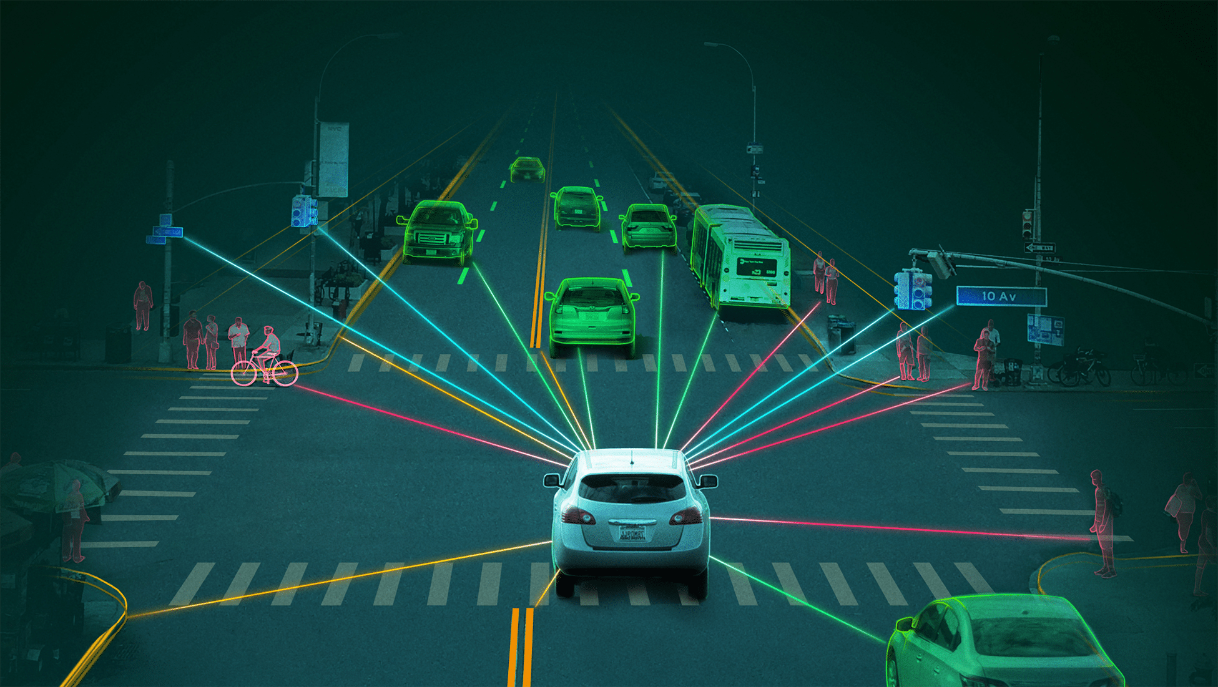
AI Domain/ sub-domain
AI Domain: Integration and Interaction Sub-Domain: Connected and Automated Vehicles (CAV’s)
AI Domain: Planning Sub-Domain: Planning, Searching, Optimisation
AI Domain: Learning Sub-Domain: Machine Learning
AI Domain: Perception Sub-Domain: Computer vision, Audio processing
Notes:
Connected and Automated Vehicles: it is an automated vehicle → no drivers
Planning , Searching, Optimisation: Planning the fastest way from home to work
Learning: pattern recognition with data (people crossing road,
Computer Vision: Uses object recognition, sensor networks, gesture recognition

Slide 7
Sources
The 6 Levels of Vehicle Autonomy Explained | Synopsys Automotive. (2020, 22 juli). Geraadpleegd op 21 september 2022, van https://www.synopsys.com/automotive/autonomous-driving-levels.html
Franzen, C. (2022, 18 mei). Nostalgia Driven: Revisiting the Vertical Highway and the Self-Driving Lexus From ‘Minority Report’. Ground Truth. Geraadpleegd op 21 september 2022, van https://groundtruthautonomy.com/entertainment/minority-report-at-20-vertical-highway-self-driving-lexus/
Rzymska, K. (2021, 25 oktober). How “Minority Report” Predicted the Future of Automotive and The Emergence of Self-driving Cars. Geraadpleegd op 21 september 2022, van https://www.comarch.com/telecommunications/blog/how-minority-report-predicted-the-future-of-automotive/
Hitachi, Ltd. (z.d.). IoT-enabled AI technologies for self-driving connected cars : Hitachi. Hitachi’s Research & Development. Geraadpleegd op 21 september 2022, van https://www.hitachi.com/rd/sc/aiblog/023/index.html
Stilgoe, J. (2017). Machine learning, social learning and the governance of self-driving cars. Sage Journals, 7-12

Slide 8
THANK YOU FOR LISTENING
ANY QUESTIONS?

